Slide 1
Southern Region Program Leaders Network
An Orientation for New Participants

Slide 2
PLN Mission
Foster and strengthen Extension education programming throughout the Southern region by promoting multi-state cooperation.
Anticipate emerging program issues and needs.
Implement action processes to address them in a timely manner.

Slide 3
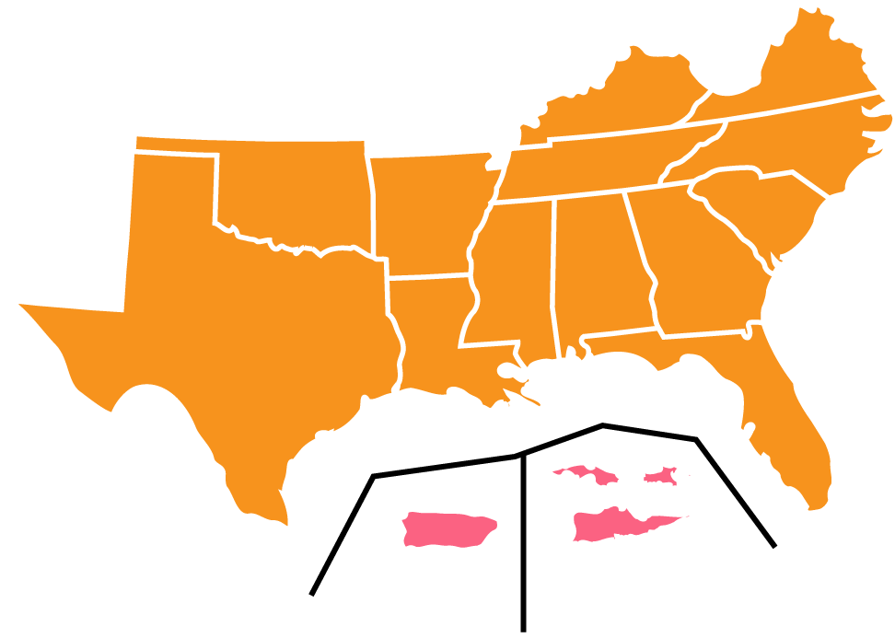
The Southern Region
13 States
Puerto Rico
U.S. Virgin Islands

Slide 4
The 1890/1994 Region
19 1890 Institutions
1 1994 Institution

Slide 5
Southern Extension Organizations
Association of Southern Region Extension Directors
(1862 Universities)
Southern Rural Development Center
Association of Extension Administrators
(1890 Universities)

Slide 6
PLN Structure Overview
AEA
1890 Administrators
ASRED
1862 Directors
Executive Committee
PLC
Program Leadership Committee
ANR
PSD
COM
MM
CD
IT
FCS
4-H

Slide 7
Program Committees (PC)
Agriculture & Natural Resources
Program
& Staff Development
ANR
PSD
Communication
COM
MM
Middle Managers
CD
IT
Community Development
FCS
4-H
Information Technology
Family & Consumer Science
4-H Youth Development

Slide 8
Program Committee Responsibilities
Identify emerging issues and opportunities.
Develop annual Plan of Work to respond.
Collaborate regionally.
ANR
PSD
COM
MM
CD
IT
FCS
4-H

Slide 9
Program Leadership Committee (PLC)
Membership comprised of individuals elected by their Program Committee plus ASRED and AEA representatives.
Roles and Responsibilities
Identify cross-committee emerging issues.
Review annual Plans of Work for Committees.
Plan Annual PLN Conference.
Carry Information and Action Items from the Committees to the Administrators and Directors.

Slide 10
Benefits: What’s in it for You?

Slide 11
Survey: What Do You Value in PLN?
Building collaborative networks (85%).
Implementing/adapting ideas/best practices (71%).
Widening one’s view of Extension work (51%).
Strengthening connections with people (46%).
Reflecting critically on my own work (42%).
Receiving training/professional development (40%).
Developing leadership skills (33%).
Gaining confidence in work/personal skills (33%).
Franz, N., Stovall, C., & Owen, M. (2009)

Slide 12
Four Results of Participating
Improved effectiveness by adopting a best practice from another state (66%).
Feel more support in my work (48%).
Think differently about my resources (48%).
Feel recharged from PLN (35%).
Changes in my work due to PLN

Slide 13
Tips for Successful First Meeting
Expand your network.
Listen to what others are doing.
Determine the fit for your state / program.
Sit with people NOT from your state.
Speak up.
Volunteer!

Slide 14
This presentation was created by Dave Shideler, Oklahoma State University Extension, and originally presented August 17, 2015.

