Slide 1
Program Committee Officer Briefing
June 4th, 2019
Notes:
Be sure to record the session and
Be sure to capture the names of who attended by committee.

Slide 2
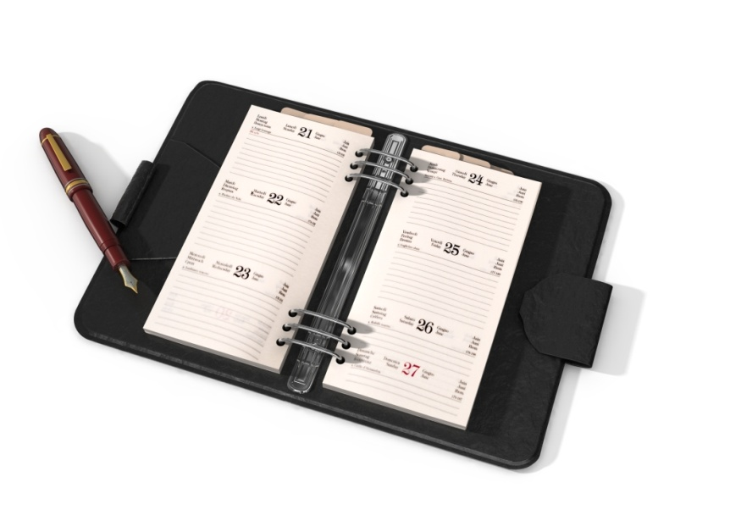
Agenda
Conference Program
Housekeeping Items and Deadlines
Action Items and Accomplishments
Evaluation of PLN

Slide 3



Mission & Purpose of PLN
Our Mission
To foster and strengthen Extension education programming throughout the southern region by:
Promoting multistate cooperation
Anticipating emerging program issues and needs
Implementing action processes to address them in a timely manner

Slide 4

Promoting Cross-Committee Efforts
Sharing agendas ahead of time
splc-regional-chair@lists.msstate.edu
Topics that may need multi-committee involvement – officers hyperlinked on website
Other ideas?
Notes:
Encourage committee officers to share committee agendas across program areas to look for common ground. They can use this email to send to the whole group.
Committees are free to make their own cross-committee connections.

Slide 5
Conference Highlights: Monday
1:00 PLC Meeting w/ Committee Chairs & Vice-Chairs
1:30 Pre-Conference: “Sudden Impact: Extension’s Response to Natural Disasters”
5:30 Newcomer Orientation: Chairs/Vice Chairs Attend
        Bring copies of agendas
        Dinner with newcomers – list sent to you in early August
Notes:
1:00 – This will be a final briefing to go over any last minute details. Committee officers will only need to be present for the first 20-30 minutes.
1:30 – Officers should be finished with the PLC meeting in time to attend the pre-conference if they choose (registration fee applies)
5:30 – All Chairs and vice chairs are asked to attend.
Please bring copies of the committee’s agenda and be ready to talk through these with new people to help them know how to plug in
A copy of the newcomer attendees’ names and emails will be provided about a week before the conference so that you can reach out to them personally
We encourage you to plan on going to dinner with newcomers. You can use the list we send to invite them.

Slide 6
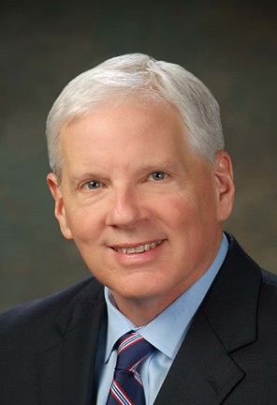
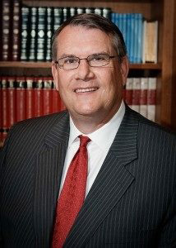
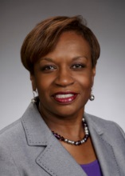
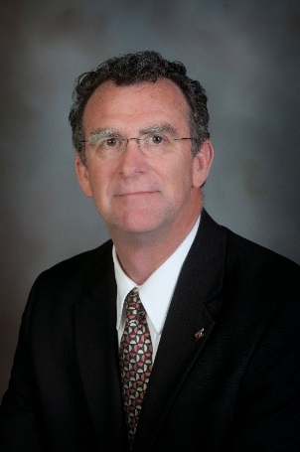
Conference Highlights: Tuesday
Panel Discussion:
  Cooperative Extension in the Future from the Perspectives of USDA NIFA and APLU
    Scott Angle, USDA NIFA
    Doug Steele, APLU
    Ed Jones, Virginia Cooperative Extension
    Carolyn Williams, Prairie View A&M
Ignite Sessions & Awards
Committee Night Out

Slide 7

Time with Administrative Advisors
Tuesday
  10:30 – 11:45
Wednesday
  1:30 – 3:00
Plan for these times to include high priority discussions where Administrator input is needed.
Notes:
Be sure to plan these times to make best use of the advisors’ time. Specifically, this is the time to talk through any high priority issues (rather than state reporting for instance).

Slide 8

Housekeeping Items: Optional State Reports
Committee’s Choice
Options to maximize meeting time:
Post online
Review on a conference call prior to meeting
Notes:
Committees can do written state reports if they choose. If the committees choose to do these, SRDC will be glad to post them online once they are gathered and organized by the chair.
You may also want to consider using a call prior to the conference to give state reports, freeing more face-to-face time for planning and working.

Slide 9
Housekeeping Items:
Update 2018-19 Plan of Work
Can be completed
pre-conference!
Due Thursday by noon
Select “Committees” tab
Select your committee
Select “2018-19 Plan of Work” DOC
Make changes to the last column & other places as relevant
E-mail to: russ.garner@msstate.edu
http://srpln.msstate.edu/
Notes:
Each committee has the responsibility of updating the Plan of Work from the current year (2018-19). This involves downloading the plan and filling in the last column on the right with information about completion (or continuation) of each proposed step.
[Take time to go to the website and show people where to find files and how to download them.]

Slide 10
Housekeeping Items:
Create New 2019-20 Plan of Work
Will be reviewed by Administrators & Directors
on Thursday afternoon
Due Thursday by noon
Template posted on PLN site
Include NEW officers & PLC representatives
Include conference call schedule (dates/times)
If using virtual meeting links (such as Zoom) instead of conference calls, please provide link information.
E-mail to russ.garner@msstate.edu
Notes:
Each committee will also be preparing a new Plan of Work for the next 12 months (2019-20).
In addition to putting in the plans for the committee, you will also include new officers and PLC representatives, along with the conference call schedule.
These will be reviewed by the directors and administrators on Thursday.
Consider selecting just a few high impact joint efforts. What can you do together that will make all of your work more effective and efficient. It is not necessary to have a long list of items. A few high quality lines is better than a full page of lesser ideas.

Slide 11

Housekeeping Items:
Elect Officers & PLC Representatives
Report new officers on 2019-2020 Plan of Work
1862/1890 PLC Representatives: 3 years
Officers: 1 year, but can move up chain
New 1890/1862 PLC Reps. accompany current Reps. to PLC meeting Thursday, August 22nd, 7:00 a.m.
Notes:
Be sure you have filled all of the officer positions for the coming year.
Note that new PLC reps. are asked to join the Thursday morning PLC meeting.

Slide 12

PLC Representatives Completing Terms
COM: ChaNaè Bradley (1890)
CRD: Iris Crosby (1890)
FCS: Laura Stephenson (1862)
IT: Terrence Wolfork (1890)
MM: Lonnie Johnson, Jr. (1862)
Notes:
These are the committees that need to appoint new PLC representatives.

Slide 13

Housekeeping Items:
Update Members’ List & Listserv
Due Wednesday
Hard copy of current list provided
Pass list around in committee meeting
Listserv: Primary email address (no aliases)
Return updated list to registration desk
Send updates throughout the year to:
Russ.garner@msstate.edu
Notes:
Updating both the membership list AND email listserv is an important task to keep the committee connected throughout the year. Please be sure to return the hard copies of these to the registration desk by WEDNESDAY.

Slide 14


Housekeeping Items: Action Items
Due Wednesday, August 21, by 3:00 p.m.
Template for Action & Accomplishment Items provided
Please do not change fonts or styles as these have to be combined for presentation.
E-mail to russ.garner@msstate.edu
Provide a cell phone
number for quick clarifications.
Notes:
Action and information items are due Wednesday at 3:00
Please do not change any fonts or styles in the template as these have to be combined into a single presentation quickly.
Be sure to provide a cell phone number of someone we can contact with questions or clarifications.

Slide 15
Action Item – Only if…
Clear & Concise Proposal that:
Requires a commitment of resources across 1862 and 1890 institutions
Changes established practice
Impacts others outside of the committee
A proposed
activity or policy decision
needing
joint
AEA and ASRED
administrator approval.
OR
Notes:
Your committee does not have to have an Action Item. Only use this slide if you have something that meets these requirements. If you do not have any Action Items, just delete the slide from the template.

Slide 16
Action Item: Good Example
Health Disparities: Family and Consumer
Sciences
Background: A regional meeting of FCS Program Leaders & Specialists is needed to:
  Provide professional development in the area of health disparities;
  Explore opportunities for multi-state and interdisciplinary efforts;
  Form teams to write proposals for funding, development or adoption of health curricula across the region.
Action Requested: Approval for regional meeting
Timeline: September 1, 2019 - August 31, 2020
Commits resources
Concise
Committee cannot move forward w/o approval

Slide 17
Action Item: Poor Example
Encourage Participation in National Meetings:
Background – Faculty of state Extension organizations have more opportunities to collaborate with colleagues on a broader scale. Participation in national meetings would give faculty more opportunities to network with their counterparts and learn of ongoing activities in which they can partner. Extension leadership is asked to consider supporting the increase in attendance by faculty to national meetings that could improve relationships and collaboration between state organizations.
Committee(s) Involved – All committees
Action Needed – Approval for professional faculty/staff
to attend national meetings.
Timeline – 2019 and beyond.
Verbose & meanders
Approval of travel decision of each administrator, not joint group
Vague

Slide 18

Accomplishments: 1 Slide per Committee
2-3 bullets describing committee’s major accomplishments
Short & to the point
Draw from past year’s Plan of Work
Demonstrate the value of your participation in this meeting
Notes:
This slide is required for all committees. It should be a quick list of the top accomplishments for each committee. These should be the top 2-3 things you have accomplished together. Avoid listing items like phone calls, etc. Rather list deliverables and impacts. Typically these will draw from your committee’s plan of work from the past year.

Slide 19

Accomplishment Examples
Established a multi-state grant writing team on food safety
Identified three common indicators for committee use across the South
Completed a position paper on the value and impact of integrated strategic communications

Slide 20

Evaluations
Online-Based Survey
Will be launched Thursday morning
Encourage participation
The data is used to guide next year.
Thanks to Scott Cummings for facilitating the survey!

Slide 21

Technology Details
Meeting rooms will have:
  Electric cart
  Internet
  Screen
You must bring (if needed):
  Laptop(s)
  Projector
Recommended: additional power strips
Notes:
Please note what the conference room will have available to you and what you must bring if you want it.
You will be responsible for your own laptop and projector needs. These will not be provided.
We also recommend that you bring additional power strips as electric outlet access will be limited.

Slide 22
Questions or Discussion?

Slide 23

Questions?

