Slide 1
Committee Officer Briefing June 22, 2023
Notes:
Dan slides 1-8
Michelle 9-14
Uma 15 to end

Slide 2
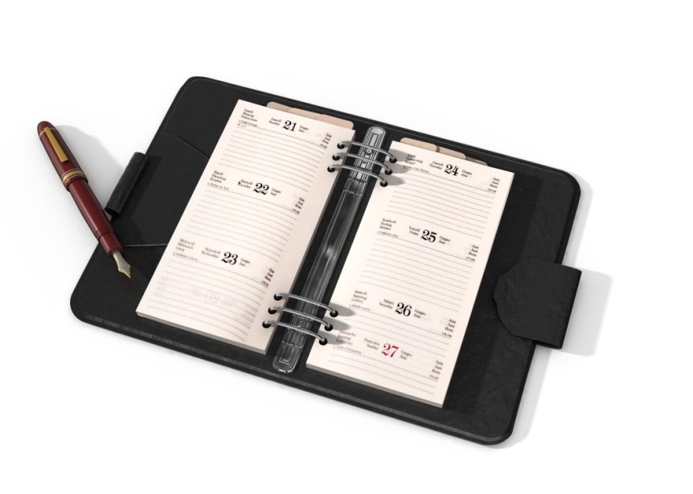
Agenda
Conference Program
Housekeeping Items and Deadlines
Decision Items, Accomplishments, and
Information
Evaluation of PLN

Slide 3
Mission & Purpose of PLN
Our Mission
To foster and strengthen Extension education programming throughout the southern region by:
Promoting multistate cooperation
Anticipating emerging program issues and needs
Implementing action processes to address them in a timely manner

Slide 4
Promoting Cross-Committee Efforts
Share agendas with other committee leaders ahead of time
splc-regional-chair@lists.msstate.edu
Look for common topics for cross-committee collaboration

Slide 5
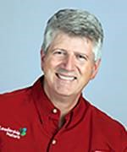
Pre-Conference
Treating Your Employees Like Volunteers
(and Your Volunteers Like Employees):
Why and how to apply the principles of leading
volunteers to the paid workforce
Pre-Conference:
Thursday, August 17, 3PM - 4:30PM ET/2PM - 3:30PM CT Post Conference:
Thursday, August 31, 3PM - 4:30PM ET/2PM - 3:30PM CT
Tom Davidson Leadership Nature http://leadershipnature.com/

Slide 6
Conference Highlights: Monday
3:00 PLC Meeting w/ Committee Chairs & Vice-Chairs
5:00 Newcomer Orientation: Chairs/Vice Chairs Attend
Bring copies of committee agendas
List of newcomers will be sent to you in mid-August
6:15 Dinner with Newcomers-Encouraged!

Slide 7
Conference Highlights: Tuesday
Keynote:
Mansfield Key, III
"Ole Pete Key" Leading Growth Development Strategist; International Motivational Speaker
Awards
Committee Night Out

Slide 8
Time with Administrative Advisors
Tuesday - 10:00 – 12:00:
Discuss Priority Topics
Wednesday - 1:30 – 3:00
Review Plan of Work, Action/Accomplishment items, etc.
Plan for these times to include high priority discussions where Administrator input is needed.

Slide 9
Housekeeping Item: Optional State Reports
Optional: Committee’s Choice
Options to maximize meeting time:
Post online
Review on a conference call prior to meeting

Slide 10
Housekeeping Item: Update 2022-23 Plan of Work
Can be completed
pre-conference!
Due Thursday by noon
Select “Committees” tab
Select your committee
Select “2022-23 Plan of Work” DOC
Make changes to the last column & other places as relevant
E-mail to: rachel.welborn@msstate.edu
http://srpln.msstate.edu/

Slide 11
Housekeeping Item: New 2023-24 Plan of Work
Will be reviewed by Administrators & Directors
on Thursday afternoon
Due Thursday by noon
Template posted on PLN site
Include NEW officers & PLC representatives
Include conference call schedule (dates/times)
E-mail to rachel.welborn@msstate.edu

Slide 12
Housekeeping Items: Elect Officers & PLC Representatives
Report new officers on 2023-2024 Plan of Work
1862/1890 PLC Representatives: 3 years
Officers: 1 year, but can move up chain
New 1890/1862 PLC Reps. accompany current Reps. to PLC meeting Thursday, August 24th, 7:00 a.m.

Slide 13
PLC Representatives Completing Terms
ANR: Dan Goerlich (1962)
4-H: Demier Richardson-Sanders (1890)
CRD: Dan Kahl (1862)
FCS: Jacquelyn White (1890)
PSD: Renysha Harris (1890)
NOTE: If someone served only a part of the term,
they could be reappointed for a full 3-year term.

Slide 14
Housekeeping Items: Update Members’ List & Listserv
Due Wednesday
Hard copy of current list provided
Pass list around in committee meeting
Listserv: Primary email address (no aliases)
Return updated list to registration desk
Send updates throughout the year to:
rachel.welborn@msstate.edu

Slide 15
Housekeeping Items: Decision Items*
*Formerly called Action Items
Due Wednesday, August 23, by 3:00 p.m.
Templates for Decision, Accomplishment, and Information Items provided
Please do not change fonts or styles as these have to be combined for presentation.
E-mail to rachel.welborn@msstate.edu
IMPORTANT:
Provide a cell phone
number for quick clarifications.

Slide 16
Decision Item – Only if…
Clear & concise proposal that:
Requires a commitment of resources across 1862 and 1890 institutions
Changes established practice
Impacts others outside of the committee
A proposed
activity or policy decision
needing
joint
AEA and ASRED
administrator approval.
OR

Slide 17
Decision Item: Good Example
Health Disparities: Family and Consumer
Sciences
Background: A regional meeting of FCS Program Leaders & Specialists is needed to:
Provide professional development in the area of health disparities;
Explore opportunities for multi-state and interdisciplinary efforts;
Form teams to write proposals for funding, development or adoption of health curricula across the region.
Action Requested: Approval for regional meeting
Timeline: September 1, 2023 - August 31, 2024
Concise
Committee cannot move forward w/o approval
Commits resources

Slide 18
Decision Item: Poor Example
Encourage Participation in National Meetings:
Background – Faculty of state Extension organizations have more opportunities to collaborate with colleagues on a broader scale. Participation in national meetings would give faculty more opportunities to network with their counterparts and learn of ongoing activities in which they can partner. Extension leadership is asked to consider supporting the increase in attendance by faculty to national meetings that could improve relationships and collaboration between state organizations.
Committee(s) Involved – All committees
Action Needed – Approval for professional faculty/staff
to attend national meetings.
Timeline – 2023 and beyond.
Verbose & meanders
Approval of travel decision of each administrator, not joint group
Vague

Slide 19
Accomplishments: 1 Slide per Committee
Bullets describing committee’s TOP 3 Accomplishments
Short & to the point
Draw from past year’s Plan of Work accomplishments
Demonstrate the value of your participation in this meeting

Slide 20
Accomplishment Examples
Established a multi-state grant writing team on food safety
Identified three common impact indicators for committee use across the South
Completed a position paper on the value and impact of integrated strategic communications

Slide 21
Information Items: Plans for 2023-24
Top 3-4 Plan of Work items for 2023-24
Short, concise bullets

Slide 22
Technology Details
Meeting rooms will have:
Electric cart
Internet
Screen
You must bring (if needed):
Laptop(s)
Projector
Recommended: additional power strips

Slide 23
Evaluations
Online-Based Survey
Will be launched Thursday morning
Encourage participation
The data is used to guide next year.
This Photo by Unknown Author is licensed under CC BY-SA

Slide 24
Questions or Discussion?

Slide 25
Questions?

